Slide 1
The association of neighborhood adversity with depression and anxiety symptoms in a low-income migrant community on the U.S.-Mexico border
REBECA JIMÉNEZ
SAN DIEGO STATE UNIVERSITY
INTERNATIONAL CONGRESS OF BEHAVIORAL MEDICINE
VANCOUVER CANADA

Slide 2
Tijuana, B.C., M.X.
San Diego-Tijuana is the world’s busiest land border crossing
Tijuana's population is estimated to be 2,259,787
Many vulnerable groups reside adjacent to the border in Tijuana's Zona Norte including people with a history of migration, deportation, sex work, substance use, and houselessness

Slide 3
Migration
& Deportation
Prior to COVID-19, over 300,000 individuals were deported each year
More than 40% of Mexican individuals deported out of the US are repatriated to Tijuana
Enforcement USIAC. Detention Management 2022. https://www.ice.gov/detain/detention-management

Slide 4
Migration & Mental Health
Donato et al., 2019, Front Psychiatry.
Notes:
- Many previous studies have shown that international migrants are at high risk for adverse mental health conditions
- A study looked at mental health outcomes by migrant status in Mexico, among returned U.S. migrants, internal migrants that have only migrated within Mexico, and non-migrants.
- Using data collected in 2017 from the Mexican Retrospective Demographic Survey and National Survey of Households, there were significant differences among the three groups across three health outcomes: anxiety, pain, and fatigue
- However, depression was not significantly different between migrant status
- Both U.S. migrants and internal Mexican migrants reported more anxiety and pain, but only internal Mexican migrants reported more fatigue
Data has shown migrants who migrate in Mexico and internationally have poorer mental health

Slide 5
Migrants & deportees living along international borders are at increased risk for adverse mental health conditions
Low SES
Poor Access to Medical Care
Disrupted Employment
Psychological Stress
Lack of Social Support
Food & Housing Insecurity
Rosenthal, 2018, Curr Hypertens Rep.
Rosenthal et al., 2022, Curr Hypertens Rep.
Weigel et al., 2019, J Immigr Minor Health.
Notes:
"May have"
"May have in common"

Slide 6
Neighborhood Environment & Hispanic/Latino Health
Objectively measured neighborhood adversity (e.g., low walkability, socioeconomic deprivation) is associated with poorer health outcomes (e.g., high blood pressure, BMI, diabetes risk).
Studies of the impact of perceived (self-reported) NE on health have mixed results
Little research on NE and mental health in Latinos, e.g., depression and anxiety
Gallo et al., 2022, Am J Prev Med.
Heredia et al., 2022, Am J Health Promot.
Savin et al., 2022, Soc Sci Med.
Notes:
Emphasized PERCEIVED neighborhood environment

Slide 7
Study Aims
Aim 1: Assess the relationship of perceived neighborhood environment with depression and anxiety symptoms in a low-income migrant community in Tijuana, Mexico.
Aim 2: Examine the association of five neighborhood environment components (social cohesion, walking/exercise environment, access to healthy foods, crime/safety, aesthetic quality) with depression and anxiety symptoms in this population.

Slide 8
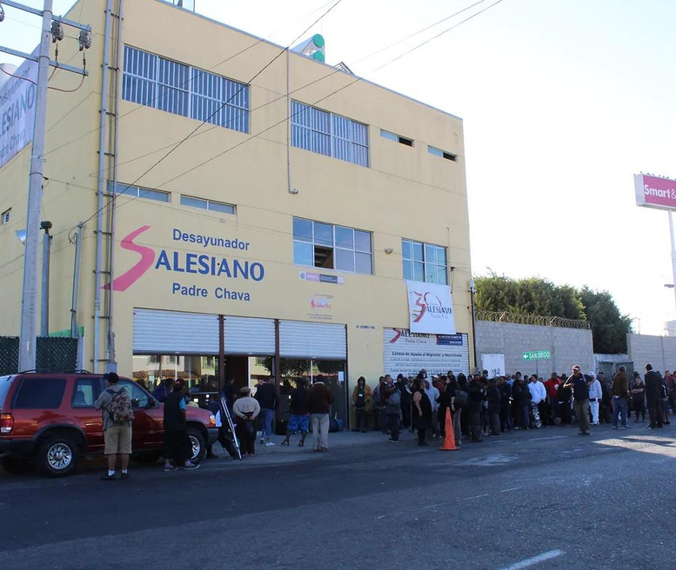
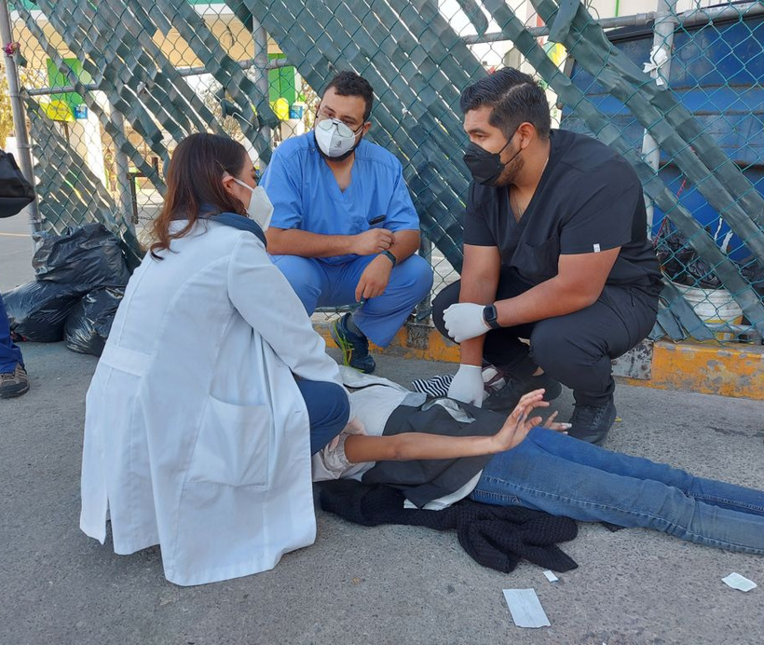
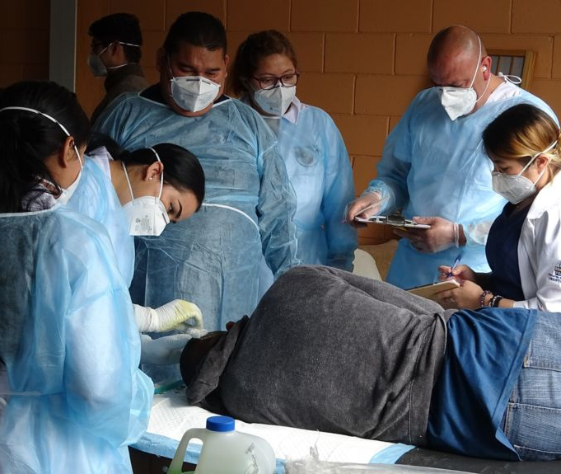
"Health Frontiers in Tijuana"
Free Medical Clinic
Run by local medical schools
Walk-in medical clinic
Co-located at a large soup kitchen & migrant shelter
~1000 fed daily
Clinic Services Offered:
Clinic Neighborhood:
Primary care
HIV/STI testing
Wound cleaning
Mental health services
Referral to emergency & social services
High-density housing
High traffic environment
High crime rates
Social stigma for deported & unhoused individuals

Slide 9
Recruitement & Procedures
Inclusion Criteria:
18 or older
Seeking free medical care from the walk-in clinic
Speak English or Spanish
Exclusion Criteria:
Acute pain or in need of immediate medical services
Inability to communicate due to intoxication, disability
Patient Flow:
Enter
Registration
Vitals
Waiting Room

Slide 10
Participants
N = 206 adults (19-83) recruited between 2016-2017
Mean age 47.2 years
77% male
76% reported history of migration to the U.S.
63% reported history of deportation (forced removal) from the U.S

Slide 11
Methods
Measures:
Verbally administered Qualitrics survey in Spanish or English
Depression symptoms: Patient Health Questionnaire-8 (PHQ-8)
Anxiety symptoms: General Anxiety Disorders Scale (GAD-7)
Neighborhood Adversity:
30-item scale created by Escheverria, Diez-Roux, & Link (2004)
5 components (subscales)
Neighborhood Adversity
Aesthetic Quality
Social Cohesion
Access to Healthy Food
Crime/ Safety
Walking/
Exercise Env.
Garcia-Campayo et al., 2010, Health Qual Life Outcomes
Kroenke et al., 2009, J Affect Disord
Escheverria et al., 2004, J UrbanHealth

Slide 12
Statistical Analyses
Descriptive statistics and linear regression analyses were conducted using R 4.2.2 GUI 1.79 Big Sur ARM build (8160) (R Core Team, 2022)
Regression analyses adjusted for age, sex, and education level
Depression
Neighborhood Environment
Anxiety

Slide 13
Results
Prevalence of clinically significant depression symptoms and anxiety symptoms were 37% and 33%, respectively
Individuals with higher neighborhood adversity had higher depression (β=0.05, p=.01) and anxiety (β=0.05, p=.03) symptoms.
Subscale Analyses:
poorer neighborhood aesthetic quality was associated with depression and anxiety symptoms
higher crime/unsafety was associated with anxiety symptoms
Neighborhood Adversity
Aesthetic Quality
Social Cohesion
Access to Healthy Food
Crime/ Safety
Walking/
Exercise Env.

Slide 14
Summary
& Conclusions
High burden of anxiety & depression symptoms indicating for the need for mental health evaluation & treatment services
Individuals with higher neighborhood adversity had more depression & anxiety symptoms
Crime and aesthetic quality may be particularly impactful
Community-level interventions that increase neighborhood safety and aesthetic quality may improve mental health outcomes in border communities

Slide 15
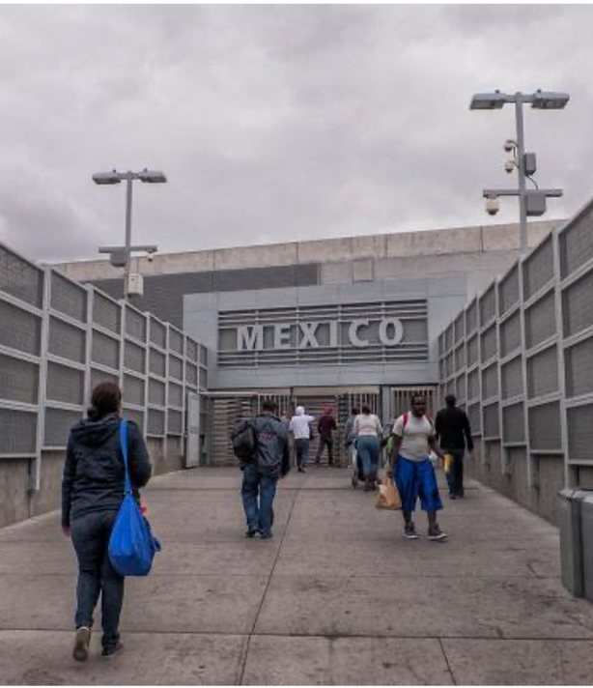
Limitations
Convenience sample
Not generalizable to all of Mexico, Tijuana residents, or border
Recruitment location is high-yield for hard-to-reach population
Cross-sectional design
Self-reported measure of neighborhood environment (vs. objective measure)
Possible bidirectional relationships between depression and anxiety symptoms and perceived neighborhood environment

Slide 16
Thank you!
Contact: rajimenez@sdsu.edu

